Slide 1
Oral Anticancer Therapy
Oncology Nursing Symposium
Saturday, May 3rd 2025
Miheer Pujara MD

Slide 2
Outline
Oral anticancer therapy logistics
Cytotoxic chemotherapy
Tyrosine Kinase Inhibitors (TKIs)
Immunomodulating drugs (IMiDs) in multiple myeloma
Hormone suppressing therapy in breast and prostate cancer

Slide 3
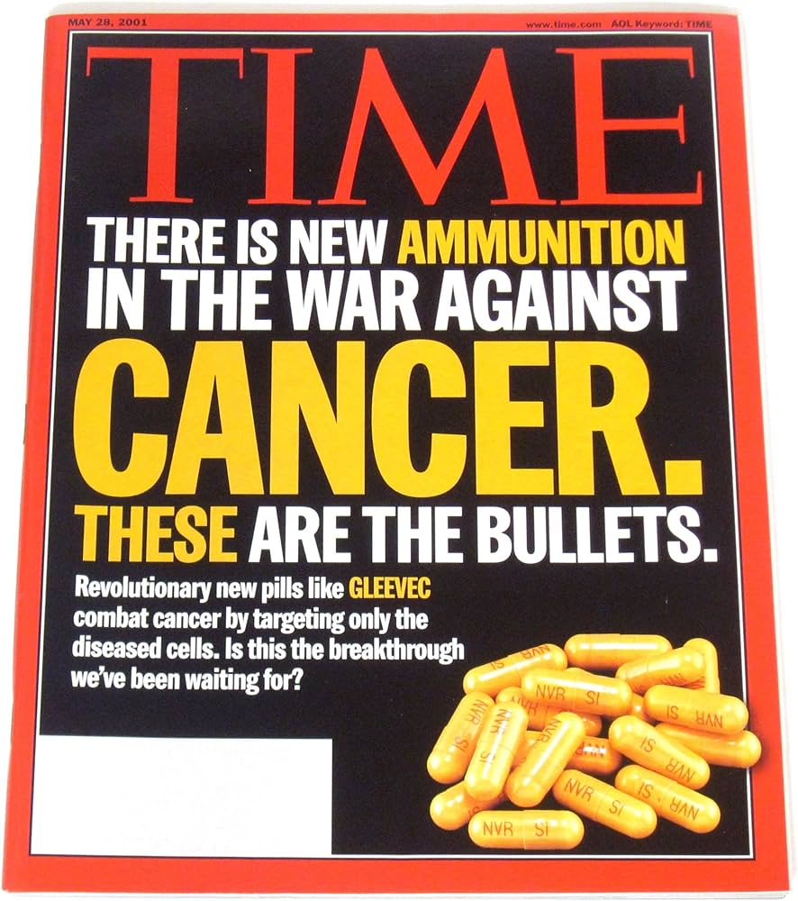
Treating Cancer: A Brief History
Hippocrates (Greek)
“Carcinos”
Galen (Greek)
“oncos”
Celsus (Roman)
“Cancer”
1896 Wilhelm Conrad Roentgen
X ray’s discovered
Theodor Bilroth
Sampson Handley
William Halstead
Stephen Paget
2001 Imatinib on the front cover of TIME
2004 first VEGF-targeted therapy approval (bevacizumab)
1917 Mustard gas used in WWI
B.A. (Before Anesthesia)
19th century: Surgery
20th century: radiation and chemotherapy
1990s – present: targeted and immune therapy
1940 Charles Huggins
Orchiectomy in prostate cancer
1990s first approval of monoclonal antibody therapy (rituximab, trastuzumab)
2010 first approval of cellular therapy (Sipuleucel-T)
1840’s
General
anesthesia
1956 First metastatic cancer cure from chemotherapy alone (choriocarcinoma)
2011 first checkpoint inhibitor approval (ipilimumab)
Notes:
https://www.cancer.org/cancer/understanding-cancer/history-of-cancer.html
https://jamanetwork.com/journals/jama/article-abstract/655915

Slide 4
Oral therapy logistics
And why nurses are so critical

Slide 5
IV vs PO
 | IV | PO
Insurance Coverage | Medical benefit (e.g. Part B) | Pharmacy benefit (e.g. Part D)
Cost | Visit-based cost-sharing (co-pays, etc.) | Drug-tier based; often higher out-of-pocket
Administration | Healthcare provider in clinic/hospital | Self-administered at home
Specialty Pharmacy
Dispenses complex and high-cost medications that are not available at retail pharmacies
Provides patient support (education, adherence, prior authorizations)
Ships medications directly to the patient’s home

Slide 6
IV vs PO
Benefits
No need for central venous access
No need to spend time in infusion – less time off work, less transportation needs, travel flexibility
Drawbacks
Efficacy depends on patient/family administration
Assessments prior to starting
Ability to swallow pills (few can be crushed)
Cognitive capacity and ability to adhere to medication schedule
Fewer interactions with healthcare = less direct monitoring for toxicity

Slide 7
Cytotoxic Chemotherapy
Killing cells that grow fast

Slide 9
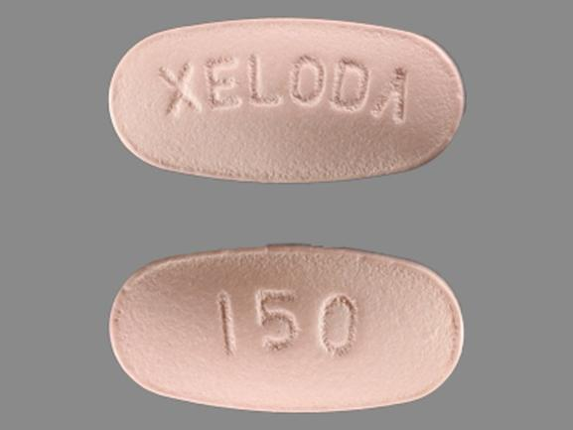
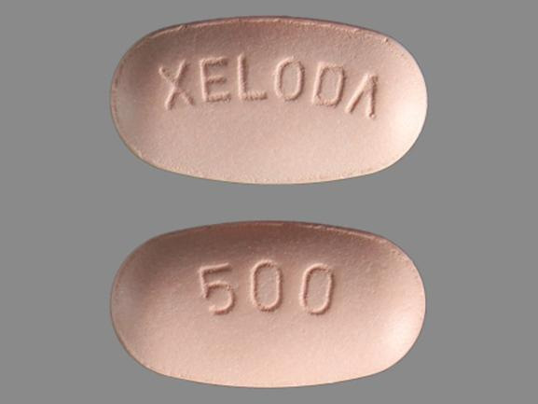
Capecitebine
Prodrug of 5-fluorouracil
Typical schedule: BID x14d / off x7d (21d cycle)
Dosing is based on BSA; pills only come in 150mg and 500mg tablets
1250mg/m2 x 1.5 m2 BSA = 1875mg
500mg x3 tablets + 150mg x2 tablets = 1800mg
5 tablets twice a day
Major toxicities: Hand-foot syndrome, N/V/D, mucositis, myelosuppression
DPYD deficiency
Dihydropyrimadine dehydrogenase breaks down 5-FU
Deficiency in 2-8% of people
Severe toxicity typically with first cycle of therapy

Slide 10
Tyrosine Kinase Inhibitors (TKIs)
Targeting proteins (aka alphabet soup)

Slide 11
Tyrosine Kinases and Tumorigenesis

Slide 12
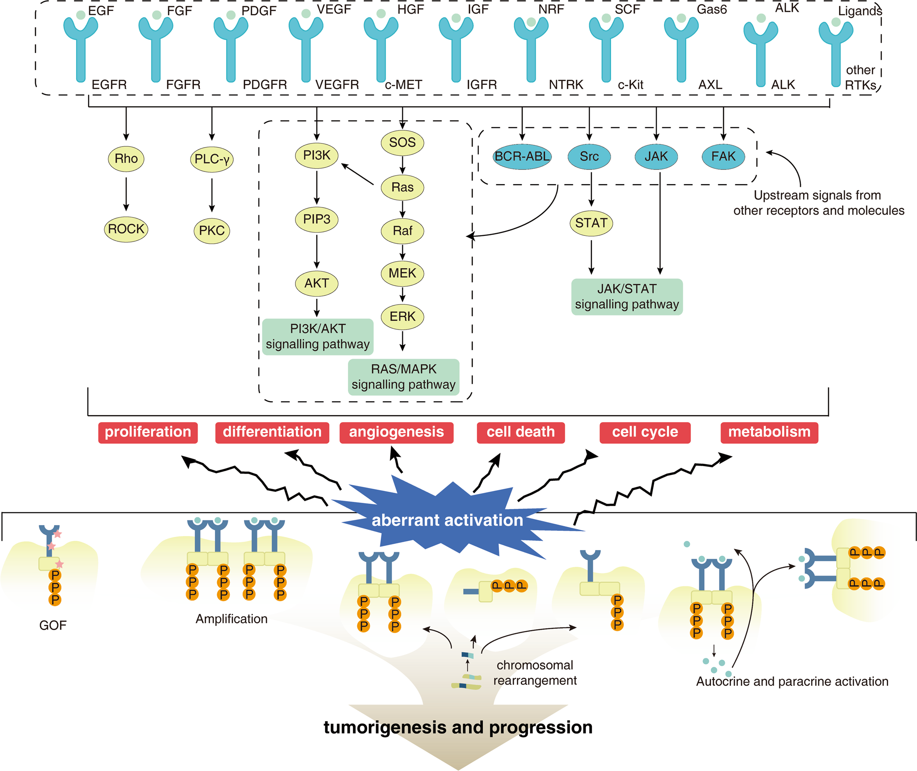
TKI Alphabet Soup
The Human Kinome

Slide 13
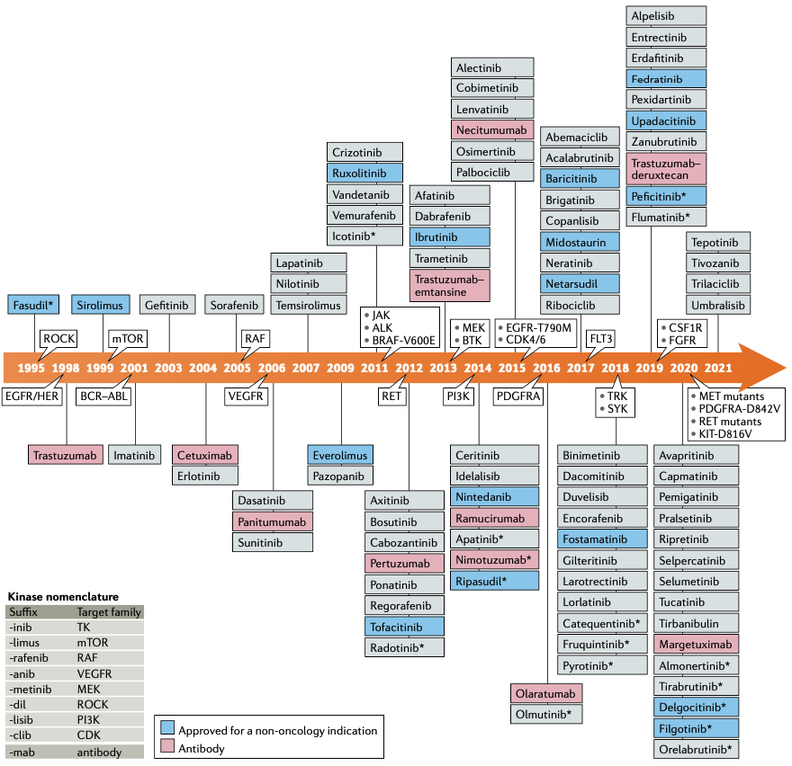
-ib = TKI
-mab = monoclonal antibody

Slide 14
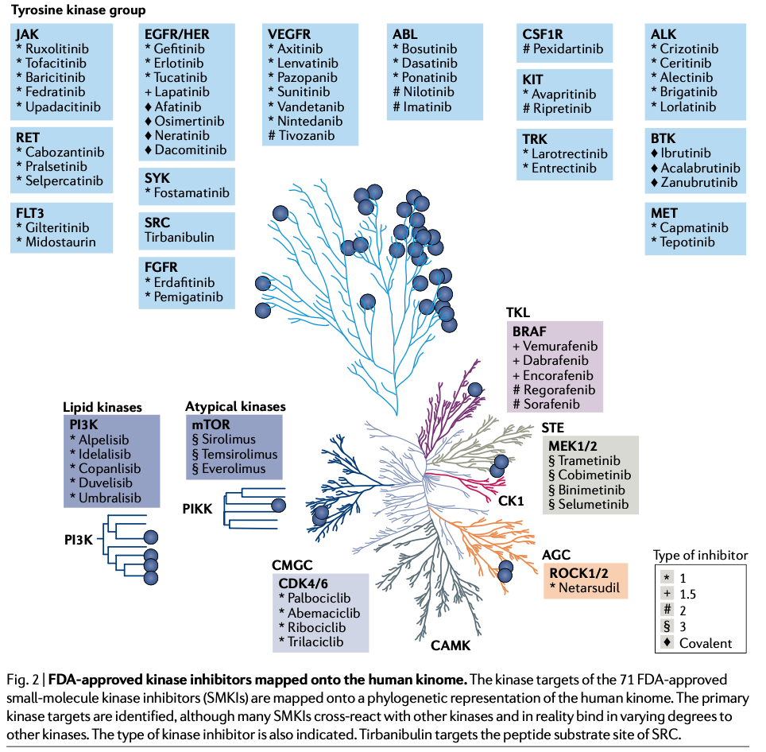
Inhibits BCR-ABL in
Chronic Myeloid Leukemia
Inhibits C-KIT, PDGF, SCF
Labeled Indications:
ALL, SM, CML,
Dermatofibrosarcoma,
GIST, HES, MDS/MPN
Multikinase inhibitor
“dirty” TKI
Broader kinase inhibition = more tumors treated = more toxicity
Rarely used now because more specific TKIs exist

Slide 15
TKI Takeaways
Tyrosine Kinases are cellular proteins that regulate cell signaling
Some cancers have mutations in Tyrosine Kinases that allow them to grow
Tyrosine Kinases can be blocked by:
Monoclonal antibody drugs (large molecules given IV/IM/SC)
Tyrosine Kinase Inhibitors (small molecules taken PO)
TKIs usually block more than one protein; some can be used for more than one cancer type
The toxicity of a TKI is related to the proteins it is blocking
May need to be held for surgery or infections (proteins involved in wound healing and immune response)
As of 2025 there are 85 FDA approved TKIs; only 2 are off patent (imatinib, erlotinib)

Slide 16
Kinase Family | Number of Approved Drugs | FDA Approved Indications | Names of Drugs
EGFR/HER2 | 11 | NSCLC, HER2-positive breast cancer | Erlotinib, Gefitinib, Afatinib, Osimertinib, Dacomitinib, Lapatinib, Neratinib, Tucatinib, Mobocertinib, Amivantamab, Lazertinib
JAK | 10 | Myelofibrosis, rheumatoid arthritis, atopic dermatitis, psoriasis | Ruxolitinib, Fedratinib, Baricitinib, Tofacitinib, Upadacitinib, Abrocitinib, Deucravacitinib, Ritlecitinib, Deuruxolitinib, Itacitinib
VEGFR | 9 | Renal cell carcinoma, hepatocellular carcinoma, thyroid cancer | Sunitinib, Sorafenib, Pazopanib, Axitinib, Cabozantinib, Lenvatinib, Regorafenib, Vandetanib, Tivozanib
BCR-Abl | 6 | Chronic myeloid leukemia, acute lymphoblastic leukemia | Imatinib, Dasatinib, Nilotinib, Bosutinib, Ponatinib, Asciminib
ALK | 6 | ALK-positive NSCLC | Crizotinib, Ceritinib, Alectinib, Brigatinib, Lorlatinib, Ensartinib
FGFR | 5 | Urothelial carcinoma, cholangiocarcinoma | Erdafitinib, Pemigatinib, Infigratinib, Futibatinib, Rogaratinib
MEK1/2 | 5 | BRAF-mutant melanoma, neurofibromatosis type I | Trametinib, Cobimetinib, Binimetinib, Selumetinib, Mirdametinib
B-RAF | 4 | BRAF-mutant melanoma | Vemurafenib, Dabrafenib, Encorafenib, Tovorafenib
BTK | 4 | B-cell malignancies, chronic lymphocytic leukemia | Ibrutinib, Acalabrutinib, Zanubrutinib, Tirabrutinib
CDK4/6 | 4 | Hormone receptor-positive breast cancer | Palbociclib, Ribociclib, Abemaciclib, Trilaciclib
mTOR | 3 | Renal cell carcinoma, breast cancer | Everolimus, Temsirolimus, Sirolimus
Flt3 | 3 | Acute myeloid leukemia | Midostaurin, Gilteritinib, Quizartinib
MET | 3 | MET exon 14 skipping mutation-positive NSCLC | Capmatinib, Tepotinib, Savolitinib
RET | 2 | RET-mutant medullary thyroid cancer, NSCLC | Selpercatinib, Pralsetinib
TRK | 2 | NTRK gene fusion-positive tumors | Larotrectinib, Entrectinib
CSF1R | 1 | Tenosynovial giant cell tumor | Pexidartinib
KIT | 3 | Gastrointestinal stromal tumor | Imatinib, Sunitinib, Regorafenib
PDGFR | 1 | Gastrointestinal stromal tumor | Imatinib
ROS1 | 2 | ROS1-positive NSCLC | Crizotinib, Entrectinib
SYK | 1 | Chronic immune thrombocytopenia | Fostamatinib
TYK2 | 1 | Psoriasis | Deucravacitinib

Slide 17
Kinase Family | FDA Approved Indications | Major/Common Toxicities | Monitoring Parameters
EGFR/HER2 | NSCLC, HER2-positive breast cancer | Interstitial lung disease, hepatotoxicity, cardiotoxicity | Liver function tests, cardiac monitoring, pulmonary function tests
JAK | Myelofibrosis, rheumatoid arthritis, atopic dermatitis, psoriasis | Serious infections, thrombosis, malignancies | CBC, liver function tests, lipid profile
VEGFR | Renal cell carcinoma, hepatocellular carcinoma, thyroid cancer | Hepatotoxicity, hemorrhage, gastrointestinal perforation | Liver function tests, blood pressure monitoring, CBC
BCR-Abl | Chronic myeloid leukemia, acute lymphoblastic leukemia | QT prolongation, Ponatinib: arterial occlusion, hepatotoxicity | ECG, liver function tests, CBC
ALK | ALK-positive NSCLC | Hepatotoxicity, interstitial lung disease, QT prolongation | Liver function tests, pulmonary function tests, ECG
FGFR | Urothelial carcinoma, cholangiocarcinoma | Ocular toxicity, hyperphosphatemia | Serum phosphate levels, ophthalmologic exams
MEK1/2 | BRAF-mutant melanoma, neurofibromatosis type I | Cardiomyopathy, retinal vein occlusion | Cardiac monitoring, ophthalmologic exams
B-RAF | BRAF-mutant melanoma | Cutaneous squamous cell carcinoma, QT prolongation | Dermatologic exams, ECG
BTK | B-cell malignancies, chronic lymphocytic leukemia | Hemorrhage, infections, atrial fibrillation | CBC, infection monitoring, ECG
CDK4/6 | Hormone receptor-positive breast cancer | Neutropenia, hepatotoxicity, QT prolongation | CBC, liver function tests, ECG
mTOR | Renal cell carcinoma, breast cancer | Infections, pneumonitis, hyperglycemia | CBC, blood glucose levels, pulmonary function tests
Flt3 | Acute myeloid leukemia | QT prolongation, differentiation syndrome | ECG, CBC
MET | MET exon 14 skipping mutation-positive NSCLC | Interstitial lung disease, hepatotoxicity | Pulmonary function tests, liver function tests
RET | RET-mutant medullary thyroid cancer, NSCLC | Hepatotoxicity, QT prolongation | Liver function tests, ECG
TRK | NTRK gene fusion-positive tumors | Neurotoxicity, hepatotoxicity | Neurologic exams, liver function tests
CSF1R | Tenosynovial giant cell tumor | Hepatotoxicity | Liver function tests
KIT | Gastrointestinal stromal tumor | Hepatotoxicity, hemorrhage | Liver function tests, CBC
PDGFR | Gastrointestinal stromal tumor | Hepatotoxicity, cardiotoxicity | Liver function tests, cardiac monitoring
ROS1 | ROS1-positive NSCLC | Hepatotoxicity, QT prolongation | Liver function tests, ECG
SYK | Chronic immune thrombocytopenia | Hypertension, hepatotoxicity | Blood pressure monitoring, liver function tests
TYK2 | Psoriasis | Serious infections, malignancies | CBC, liver function tests
Not a comprehensive list;
Check the FDA label

Slide 18
Immunomodulators (IMiDs) in Multiple Myeloma
And why the FDA created the Risk Evaluation and Mitigation Strategy (REMS) program

Slide 19
How thalidomide shaped drug regulation
1950s–60s: Thalidomide was developed in West Germany and marketed as a sedative and anti-nausea drug for pregnant women.
Sold in over 40 countries, but not in the U.S. thanks to FDA reviewer Dr. Frances Kelsey, who resisted approval due to safety concerns.
Caused over 10,000 birth defects globally (limb deformities, organ malformation)
Catalyzed major drug regulation reforms worldwide, including the 1962 Kefauver-Harris Amendments in the U.S., which required proof of drug efficacy and safety before approval.
1990s: researchers discovered that thalidomide had anti-inflammatory and anti-angiogenic properties. Found to be a potent treatment for multiple myeloma.

Slide 20
How thalidomide shaped drug regulation
1998: Celgene launched STEPS (System for Thalidomide Education and Prescribing Safety) under FDA oversight – the first major structured pharmaceutical risk management program.
Mandatory prescriber and pharmacy certification
Informed patient consent
Mandatory pregnancy testing before and during treatment
Limited distribution only through certified channels
Education on risks and contraception
2007: REMS program formally created by the FDA Amendments Act, STEPS incorporated into REMS.
Thalidomide is the archetype for REMS: a drug with clear benefit in a very specific population, but unacceptable risk without serious controls.

Slide 21
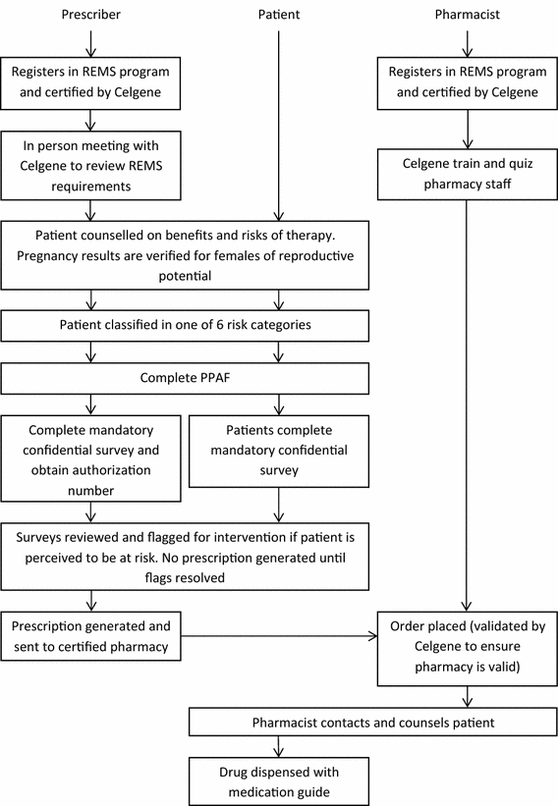
REMS in practice

Slide 22
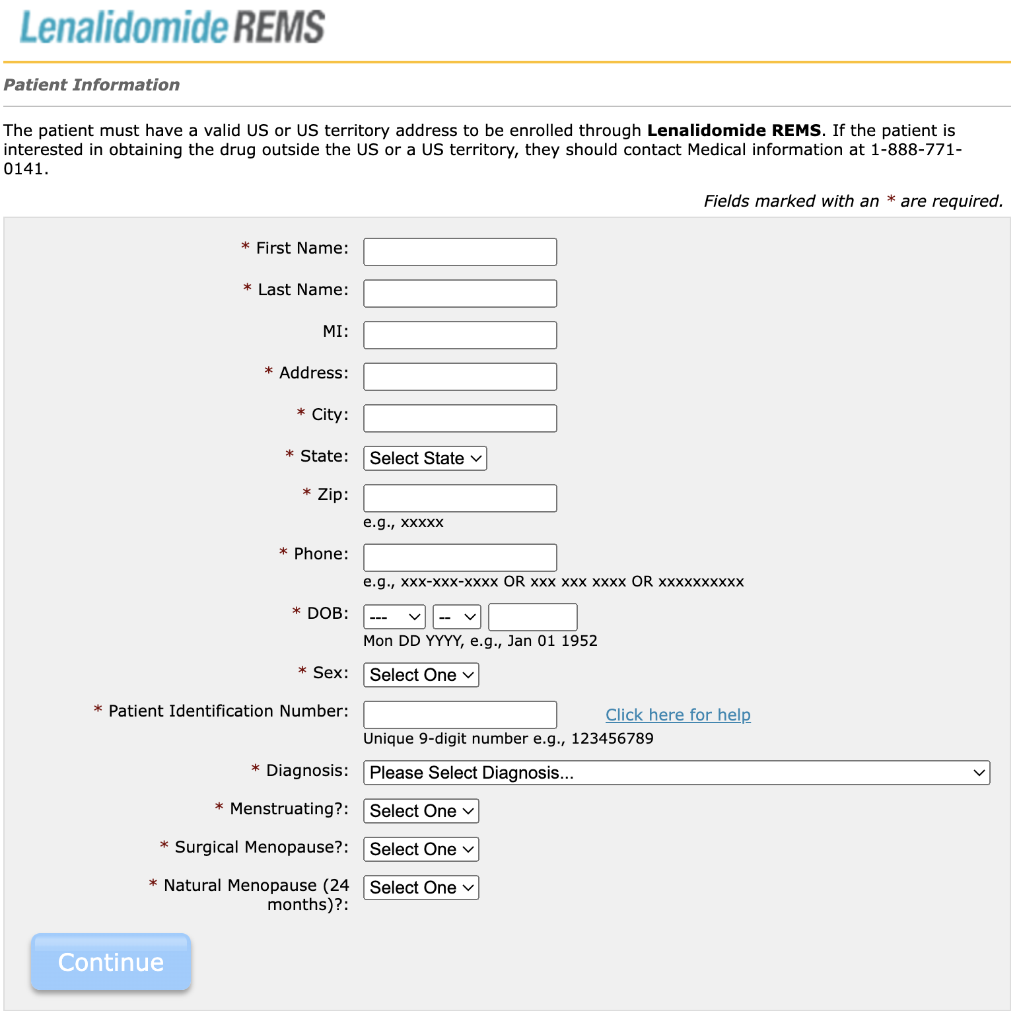
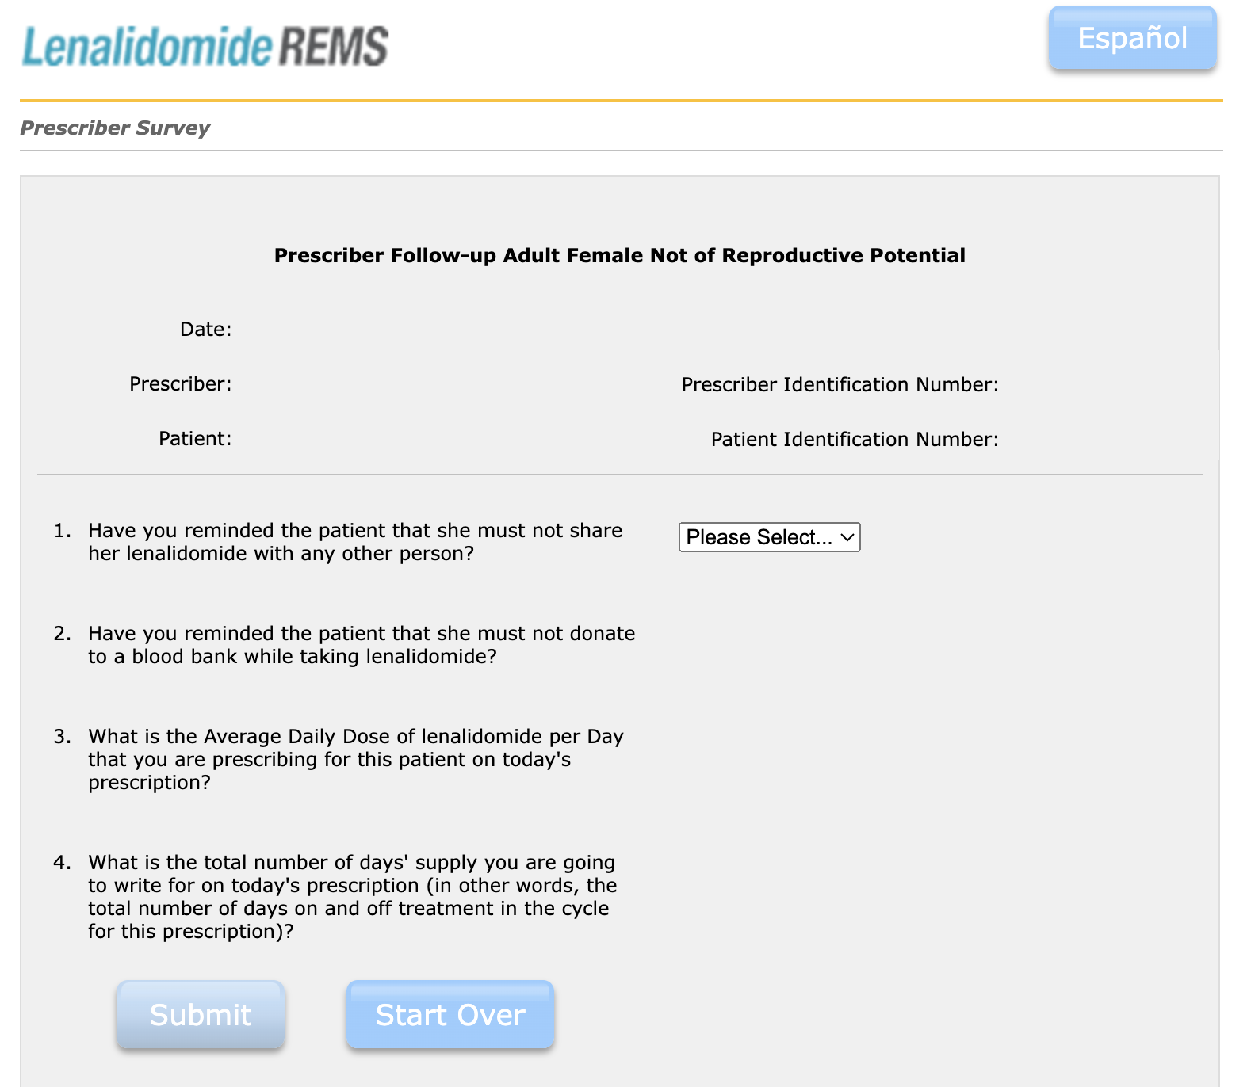
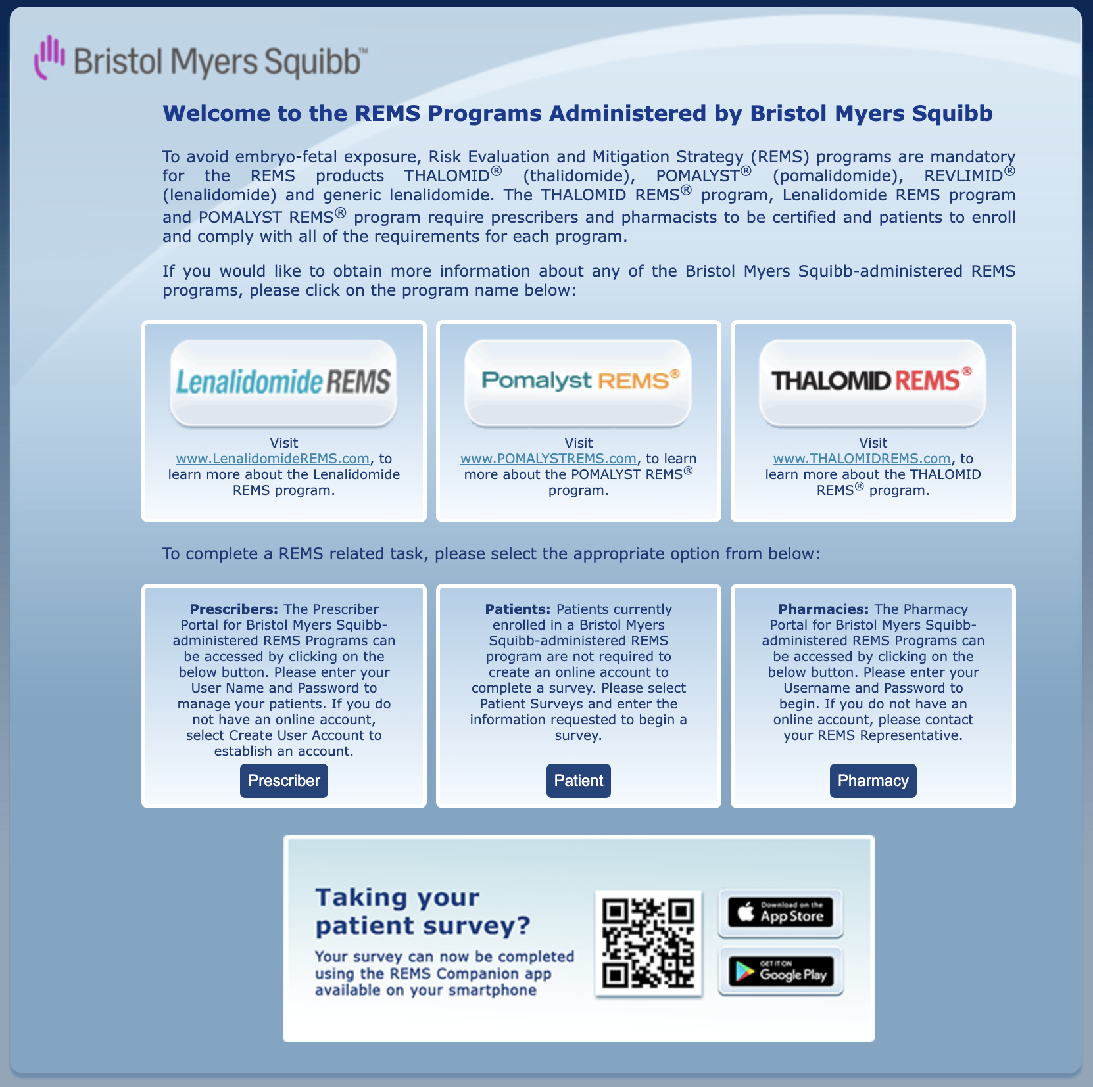
REMS in practice
https://bmsremspatientsafety.com/
Every refill
8 digit authorization number must be submitted with prescription
New Enrollment

Slide 23
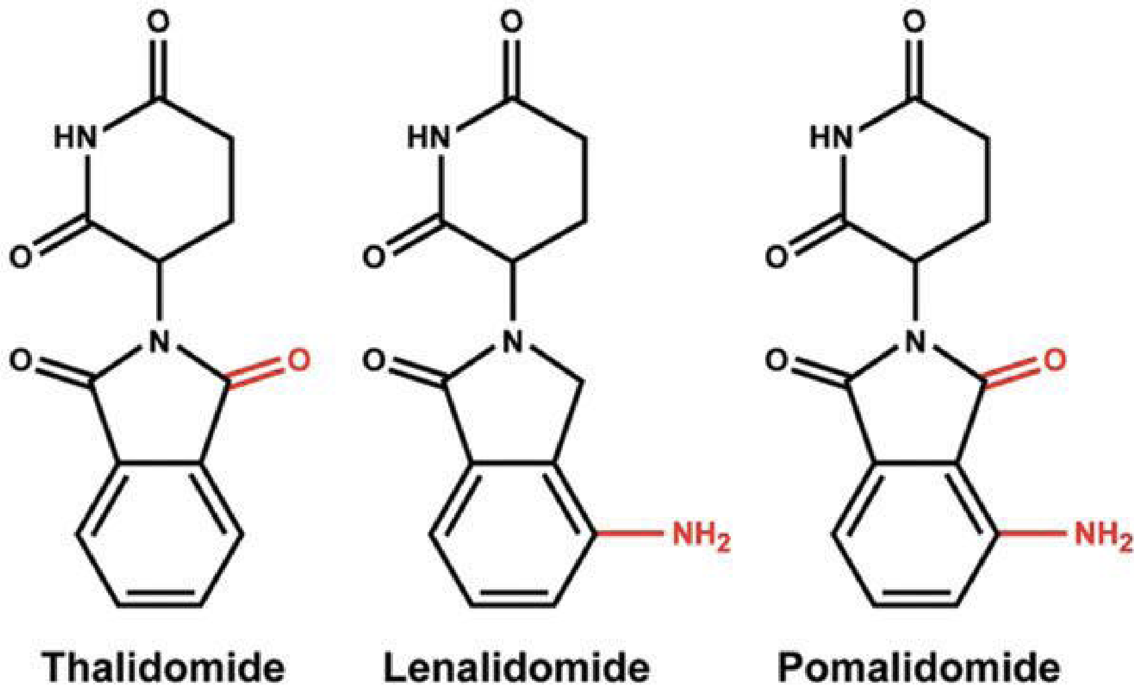
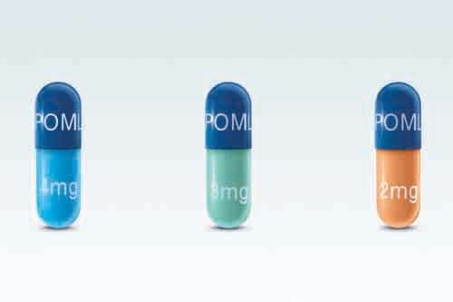
IMiDs
Backbone of most frontline and second line myeloma regimens
Dose-adjusted for renal function
Renal failure is a common presentation of myeloma and may prevent the safe use of IMiDs
Risk of VTE – ASA or DVT prophylaxis indicated
Myelosuppression
Rash

Slide 24
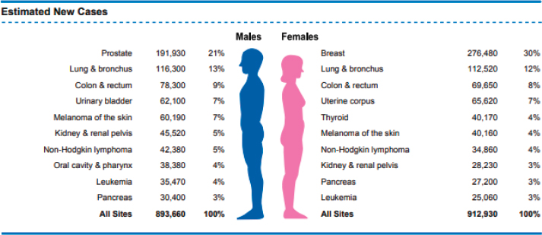
Hormone suppressing therapy
The most common treatment for the most common cancers

Slide 25
Hormone suppressing agents
Estrogen
GnRH agonists
Goserelin (SC)
Aromatase Inhibitors (AIs)
Letrozole, Anastrazole, Exemestane
Selective Estrogen Receptor Modulators (SERMs)
Tamoxifen, Raloxifene
Selective Estrogen Receptor Degraders (SERDs)
Fulvestrant (IM), Elacestrant (PO)
Testosterone “Androgen Deprivation Therapy”
GnRH agonists/antagonists
Leuprolide (IM/SC)
Degarelix (SC), Relugolix (PO)
CYP17 inhibitor
Abiraterone
Androgen receptor antagonists
Bicalutamide
Enzalutamide, Apalutamide, Darolutamide

Slide 26
Tamoxifen vs AIs
Tamoxifen can be used in pre and post-menopausal women
AIs must be combined with ovarian suppression (GnRH agonist goserelin) if used in pre-menopausal women
Common toxicities
Vasomotor symptoms (hot flashes)
Arthralgias
Vaginal dryness, sexual dysfunction
Mood changes – depression, anxiety, irritability, insomnia, fatigue
Tamoxifen
Increases bone density
VTE
Uterine cancer – any new abnormal uterine bleeding should be evaluated
AIs
Decrease bone density

Slide 27
Abiraterone & ARAs
All of these intensify the toxicities of ADT
Vasomotor symptoms (hot flashes)
Decreased bone density
Loss of skeletal muscle, increased adiposity
Anhedonia, erectile dysfunction
Mood changes – depression, anxiety, irritability, insomnia, fatigue
Abiraterone
Must be taken on an empty stomach
Must be given with prednisone 5mg to prevent mineralocorticoid excess
Can worsen baseline hypertension/diabetes
Early hepatotoxicity – monitor LFTs every 2 weeks for 3 months when starting

Slide 28
Conclusions
Oral anti-cancer drugs are dispensed by specialty pharmacies
Cytotoxic chemotherapy is rarely given in PO form; capecitebine is the most common
Tyrosine kinase inhibitors block the proteins cancer cells use to grow
There’s a new one every month and they all have unique toxicities and monitoring parameters – so check the FDA label!
IMiDs in multiple myeloma require use of the FDA REMS program
Many oral anticancer therapies need to be held briefly for surgeries or severe infections

Slide 29
References
https://www.myamericannurse.com/cne-oral-chemotherapy/
https://www.cancer.gov/news-events/cancer-currents-blog/2020/avapritinib-gist-pdgfra-alteration-fda-approval
https://pubmed.ncbi.nlm.nih.gov/34354255/
https://www.nature.com/articles/s41573-021-00252-y
https://www.nature.com/articles/s41392-024-01899-w
https://www.nature.com/articles/s41392-022-01168-8
https://www.drugs.com/image/xeloda-images.html
https://www.cellsignal.com/learn-and-support/protein-kinases/human-protein-kinases-overview
https://www.sciencedirect.com/science/article/pii/S0092867423002167?s=08
https://pubmed.ncbi.nlm.nih.gov/40252783/
https://nap.nationalacademies.org/read/25956/chapter/5

